Slide 1


Slide 2
DATE : 20, April 2020. 28, Sha’aban 1441AH
SUBJECT : Information communication Technology (ICT)
Topic : HOW TO SETUP A DESKTOP COMPUTER SYSTEM

Slide 3
In this lesson we will be achieving the following objectives.
We will revise computer hardware and Software
We will revise input and output devices

Slide 4
Hardware And Software
What are Hardware?
Hardware are the Physical Parts of the computer that we can see, touch and feel.
What are Software?
software are set of instructions that tell the computer what to do. You cannot touch or feel the software.

Slide 5
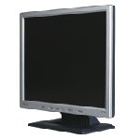
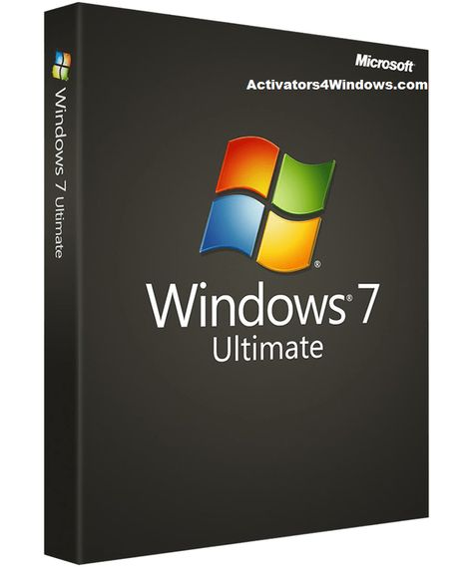
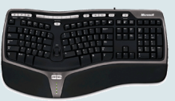


Look at the following images
Can you identify the Hardware and Software

Slide 6
The Hardware is divided into
1. Input Devices - puts information into the computer
2. Output Devices- brings out information from the computer
3. Central Processing Unit- process data in the computer
4. Memory - to store information on the computer

Slide 7
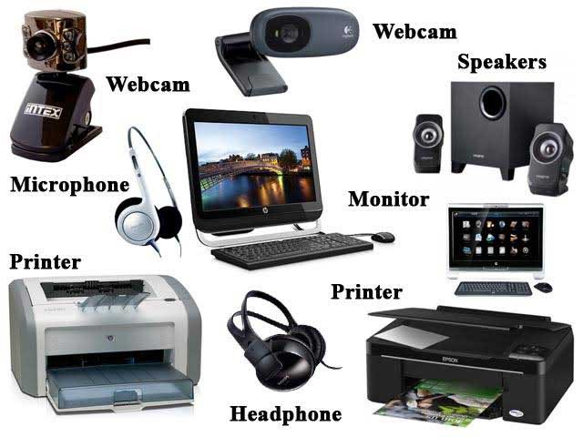
Identify the Input and Output devices

Slide 8
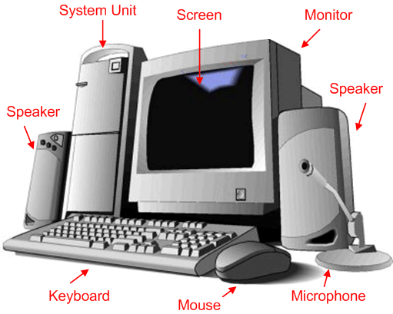
Computer System

Slide 9
MASHA ALLAH
have a tea☕
Now Give Yourself a loud Takbeer
You have just completed the revision
for today.
shall we go to the next stage..

